Slide 1
內部控制實務案例簡介
博識企業管理顧問有限公司
副總經理 楊欽榮 主任顧問師
2019-12-12

Slide 2

講師簡歷
楊欽榮 顧問師
臺灣科技大學管理研究所
臺北工專工業工程與管理科
中華民國內部稽核師 國家醫療品質獎評審委員
博識企管 副總經理
神通電腦教育、豐興鋼鐵、晉辰科技等機構管理、企劃部門主管
TQM活動推行、ISO國際驗證、醫院評鑑、內控制度建立、策略規劃與平衡計分卡、經營管理、服務品質系列講座
輔導各公民營企業組織TQM、ISO超過150家
經濟部、勞動部、勞動力發展署、勞動力發展署中彰投分署、高屏澎東分署、職安所、技檢中心、板橋、桃園、新竹、臺中地方法院、基隆、桃園、宜蘭地方法院檢察署、臺大醫院、成大醫院、臺中榮民總醫院、嘉義分院、埔里分院、高雄榮民總醫院、臺南分院、屏東分院、高醫附院、高雄長庚、嘉義基督教醫院、聖馬爾定醫院、若瑟醫院、臺中科技大學、公賣局南投、嘉義、隆田、屏東酒廠、富邦保險、統一超商、…
1
Notes:
1

Slide 3
課程綱要
漫談內部控制制度
政府內部控制制度簡介
政府內部控制制度設計流程
內部控制之風險評估
內部控制之控制作業
內部控制之自行評估
內部控制之內部稽核

Slide 4
漫談內部控制制度

Slide 5



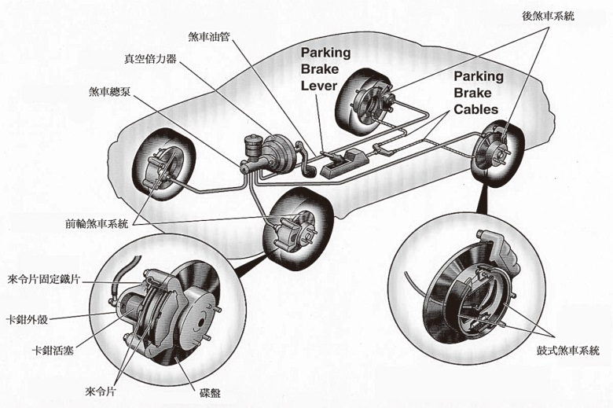
好好開車的條件
確認目標
風險評估
執行內控
設計內控
Notes:
4

Slide 6
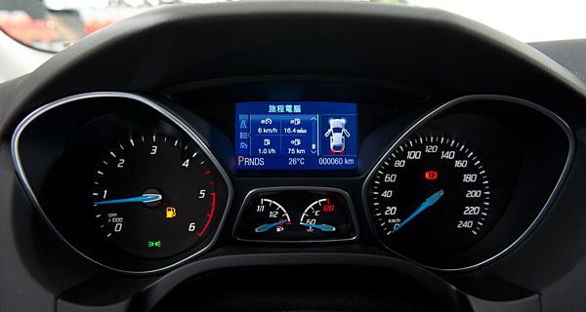

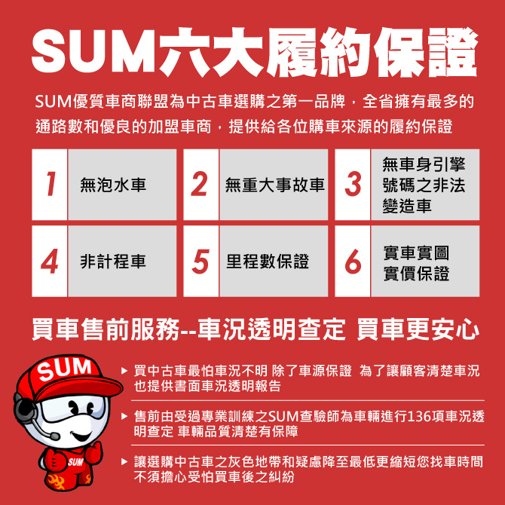

好好開車的條件
例行監督
自行評估
內控聲明
內部稽核
Notes:
5

Slide 7
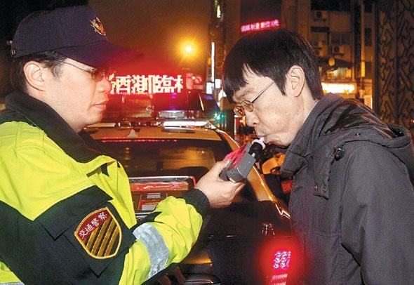
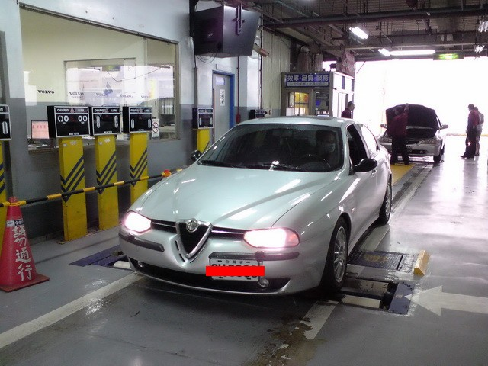

好好開車的條件
外部稽核
Notes:
6

Slide 8
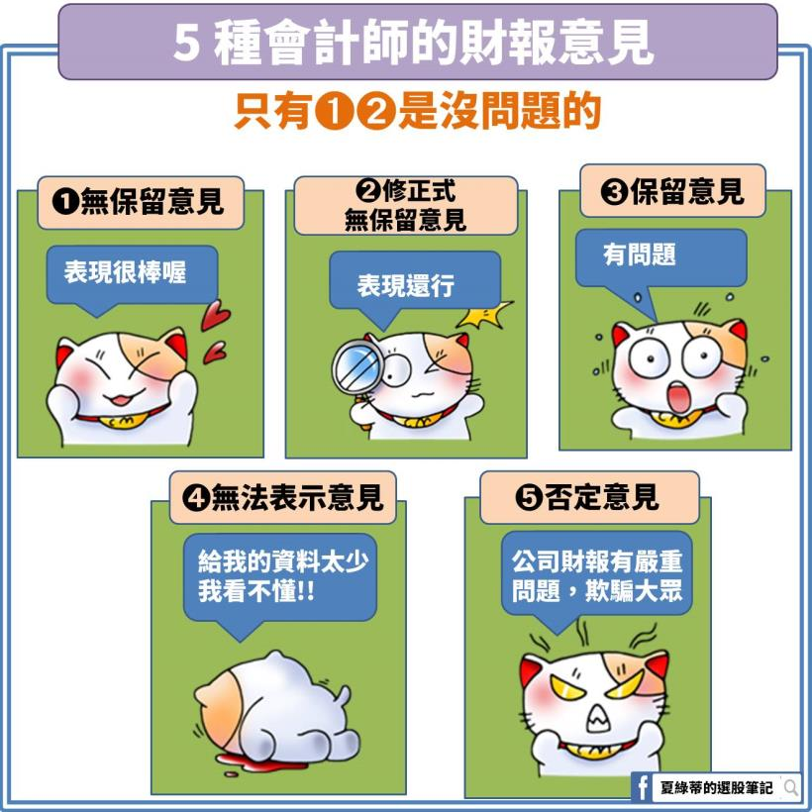
會計師財務報表簽證意見
Notes:
7

Slide 9
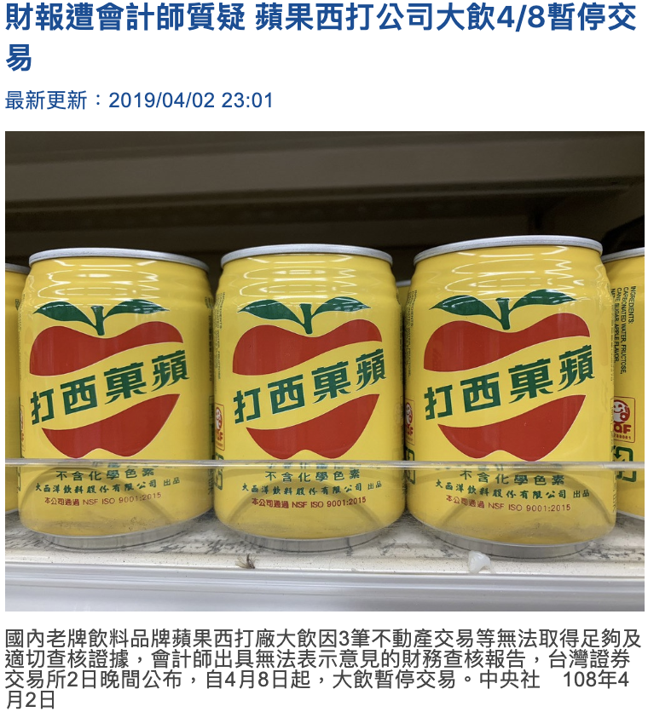
會計師財務報表簽證意見結果
民國56年成立
資本額5.66億
2018年營收約6億
蘋果西打占5.4億
高達9成
Notes:
8

Slide 10
幾個內控案例
管帳不管錢
採購不驗收
零用金盤點
庫存盤點
老公的荷包
小孩的遊戲時間
Notes:
9

Slide 11
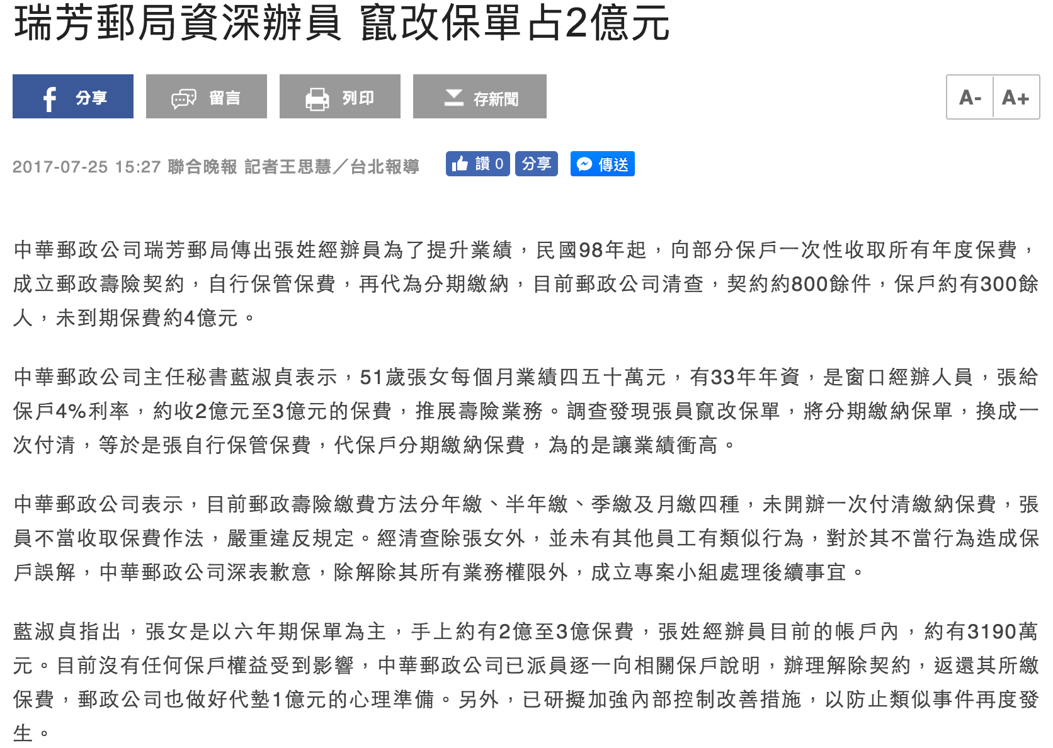
幾則內控新聞
Notes:
10

Slide 12
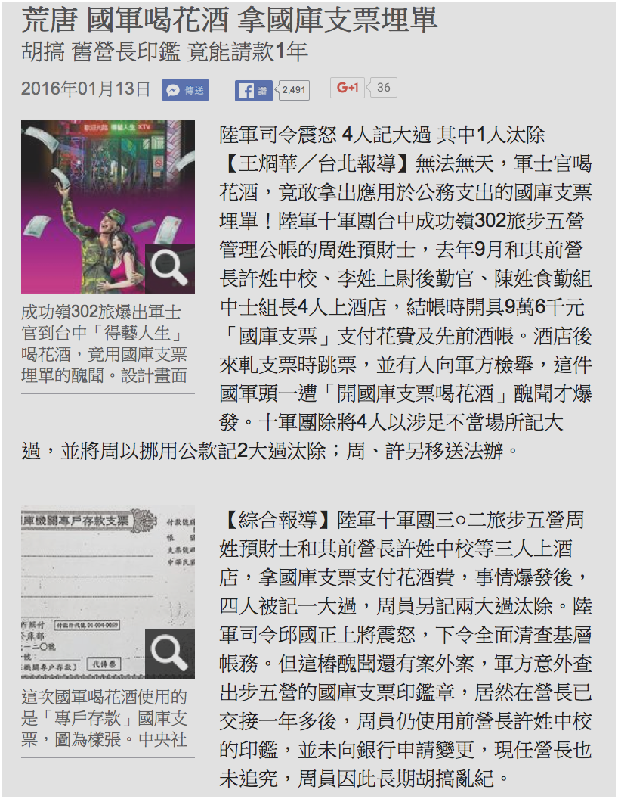
幾則內控新聞
Notes:
11

Slide 13

幾則內控新聞
Notes:
12

Slide 14
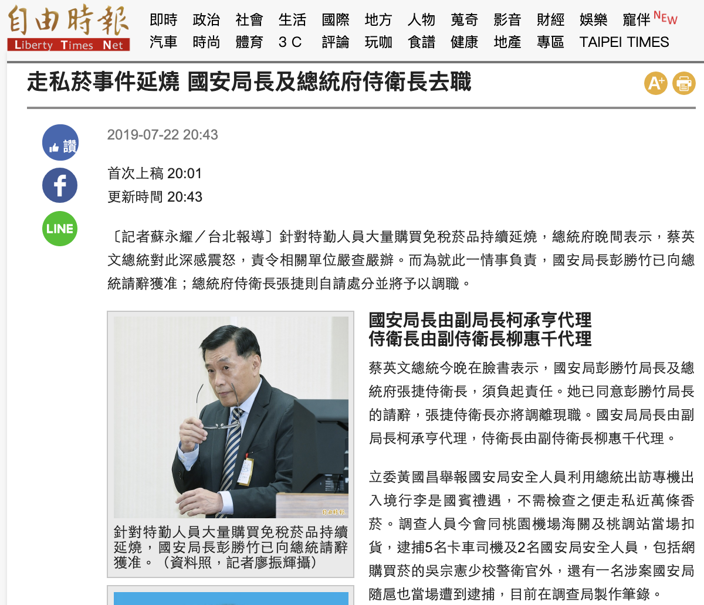
幾則內控新聞
Notes:
13

Slide 15
政府內部控制制度簡介

Slide 16
目標、風險與控制
使命/願景
機關目標
單位目標
單位目標
單位目標
風險
風險
風險
風險
風險
風險
控制
控制
控制
控制
控制
控制
內部流程
人員
系統
15
監督

Slide 17
政府內部控制的定義及觀念
何謂內部控制：
係由機關全體人員參與 →人人有責
共同設計、執行及維持的管理過程 →五項要素
藉以合理促使達成其目標 →四項目標
高階主管(尤其是首長)對內部控制制度的有效設計、執行及維持，負主要責任
透過五項互有關聯的組成要素，整合內部各種控管及評核措施
按五項要素逐一檢視
、評估內部控制制度的有效性
內部控制制度有其先天限制
不論設計及執行如何有效，僅能合理促使而非絕對保證目標的達成
16

Slide 18




政府內部控制的目標及要素
法令遵循
資產安全
可靠資訊
四項目標：
● 實現施政效能
● 提供可靠資訊
● 遵循法令規定
● 保障資產安全
施政效能
施政效能
業 務 2
業 務 1
五項要素：
1.控制環境：機關文化、內部控制認知
2.風險評估：辨識、分析與評量風險
3.控制作業：預防性或偵測性之功能
4.資訊與溝通：蒐集編製資訊與溝通
5.監督：合理確保內控有效運作
監 督
資 訊 與 溝 通
單位
B
單位
A
控 制 作 業
風 險 評 估
控 制 環 境
～政府內部控制整體架構～
機關各單位及業務，經整合五項組成要素，合理促使達成四項目標
17
Notes:
17

Slide 19
機構內控與家庭管理
機構管理
家庭管理
1.控制環境
機關文化、內部控制認知
2.風險評估
辨識、分析與評量風險
3.控制作業
預防性或偵測性之功能
4.資訊與溝通
蒐集編製資訊與溝通
5.監督
合理確保內控有效運作
→家風、家訓
→家境、家道
→家常、家規
→家務、家傳
→家教、家法
18
Notes:
18

Slide 20
政府內部控制制度設計流程

Slide 21
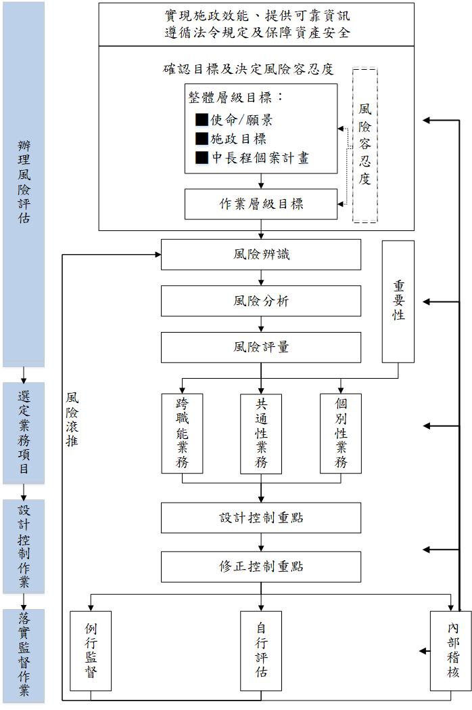
政府內部控制制度設計流程2/2

Slide 22
政府內部控制制度設計流程2/2

Slide 23
內部控制之風險評估

Slide 24

主要依據法規
中華民國104年7月13日
行政院院授主綜規字第1040600380號函
政府內部控制制度設計原則
貳、設計並維持有效內部控制制度
三、各機關內部控制制度之設計，應針對可能影響內部控制目標達成之重大風險加以控管，以強化該制度之有效性，其步驟如下：
（一）辦理風險評估：各機關得參考行政院所屬各機關風險管理與危機處理作業基準及作業手冊之觀念、方法，按下列程序辦理：

Slide 25
風險評估程序
「辦理風險評估」，各機關得參考「行政院所屬各機關風險管理及危機處理作業基準」與「作業手冊」之觀念及方法，按下列程序辦理：
1.確認目標及決定風險容忍度
2.風險辨識
3.風險分析
4.風險評量
5.風險滾推

Slide 26
確認目標及決定風險容忍度
1.各機關應由上而下確認整體與作業層級目標，以實現施政效能、提供可靠資訊、遵循法令規定及保障資產安全：
(1)整體層級目標：依機關設立使命、願景、施政目標及中長程個案計畫等，確認整體層級目標
(2)作業層級目標：配合整體層級目標，為達成內部各單位業務職掌，以作業類別或作業項目為基礎所設定之作業層級目標。
2.各機關組織架構調整或業務增減變動時，應一併檢視修正整體與作業層級目標。
3.各機關應決定適切之風險容忍度；所稱風險容忍度，指機關所願意承受整體與作業層級目標無法達成之變動程度。

Slide 27
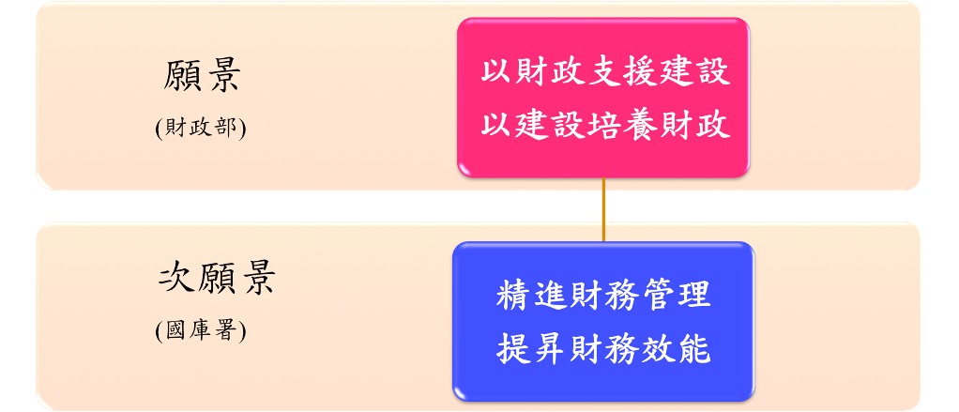
確認目標
以財政部為例
整體層級目標
作業層級目標
當國庫署視為財政部業務單位時。
資料來源:財政部組織管理彙編
26

Slide 28
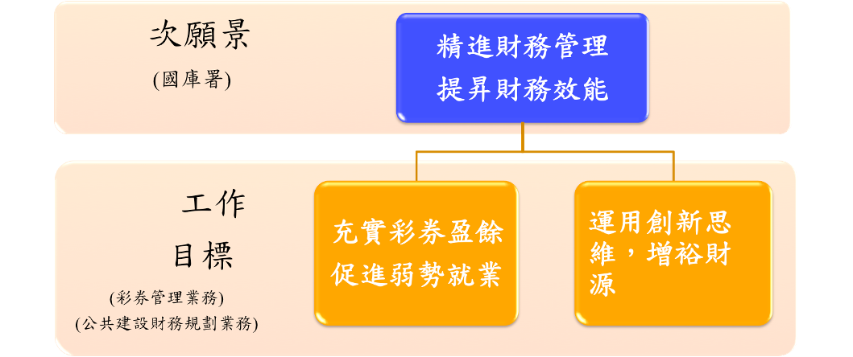
設計步驟
以財政部為例
整體層級目標
當國庫署視為獨立機關時。
作業層級目標
資料來源:財政部組織管理彙編
27

Slide 29
風險辨識
各機關應全面發掘可能影響整體與作業層級目標無法達成之內、外在風險因素，並於辨識過程中注意下列事項，以避免遺漏機關潛在之施政風險
1.應完整辨識整體與作業層級目標無法達成之風險。
2.對於施政計畫之先期規劃作業，應針對民意及利害關係者意見、成本效益、技術可行性或跨機關業務協調等，辨識可能影響計畫推動之風險來源。
3.辨識監察院等外部監督機關所提內部控制缺失，涉及業務推動過程中未能察覺或辨識之潛在風險。
4.對於涉及人民權利或義務之業務，應針對可能發生受賄、違背職務、濫用職權、消極不作為、行政效率不彰及未適當公開資訊等，辨識影響政府公信力之風險來源。

Slide 30
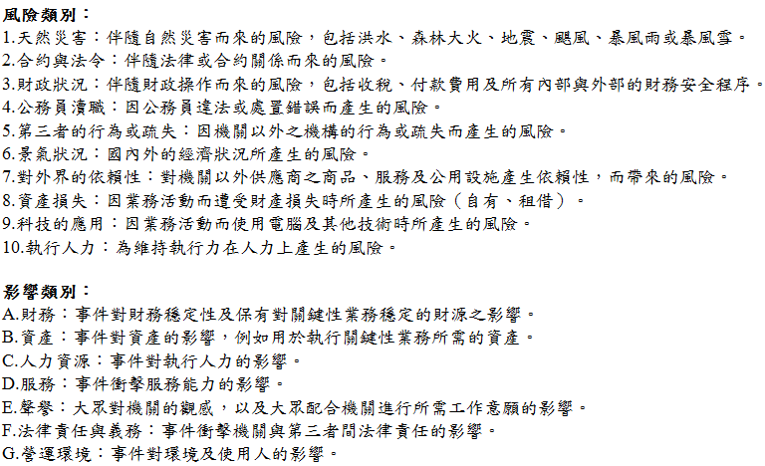
風險辨識工具

Slide 31
風險分析
各機關依據業務性質訂定適切之風險影響程度及發生可能性（機率）之分類標準，並參考以往經驗或現行作業缺失，透過量化方式，分析各項風險之風險情境一旦發生之衝擊或後果及其發生可能性，以決定風險值。

Slide 32
風險分析工具
影響之敘述分類表
定性
等級 | 衝擊或後果 | 形象 | 目標達成
3 | 非常嚴重 | 機關形象受損 | 經費/時間大量增加
2 | 嚴重 | 跨部門形象受損 | 經費/時間中度增加
1 | 輕微 | 部門形象受損 | 經費/時間輕微增加
機率之敘述分類表
半定量
等級 | 可能性分類 | 發生機率百分比
3 | 幾乎確定 | 61-100%
2 | 可能 | 41-60%
1 | 幾乎不可能 | 0-40%
資料來源：風險管理及危機處理作業手冊(p33、88)
註：機關應依業務特性，自行擇用妥適的風險評量標準

Slide 33
風險評量
各機關經綜合考量風險分析結果及風險容忍度，編製風險評估及處理彙總表及繪製風險圖像，決定需優先處理之風險項目，包含超出可容忍風險值之主要風險項目，以及未超出可容忍風險值但基於重要性原則（如以前年度已發生內部控制缺失者）納入控制作業之風險項目，研議及採取適當新增控制機制，如決定採設計控制作業方式回應，應及時設計且落實執行之，以降低風險。

Slide 34
風險評量工具
風險圖像
A1、A2等符號為主要風險項目代號
影響程度 | 風險分布
非常 嚴重(3) | A1、A2 | B1
嚴重(2) | E1 | D1 | E2
輕微(1) |  | C1
 | 幾乎不可能(1) | 可能(2) | 幾乎確定(3)
發生機率
資料來源：風險管理及危機處理作業手冊(p34、92)

Slide 35
風險滾推
各機關應配合政策、業務或法令規定等之變化，採滾動方式定期辦理風險評估作業，據以檢討及評量各風險項目，以決定是否需採行其他新增控制機制因應該等風險。

Slide 36
內部控制制度風險分析表填寫說明1/2
風險項目 | 風險情境 | 現有控制機制 | 現有風險分析 |  | 風險值 (R)= (L)x(I) | 新增控制機制 | 殘餘風險分析 |  | 風險值 (R)= (L)x(I) | 負責單位
 |  |  | 可能性 (L) | 影響程度 (I) |  |  | 可能性 (L) | 影響程度 (I)
績效評核指標檢討 | 各項關鍵績效指標(KPI)項目未達年度設定目標值。 | 每年年底提報達成情形 | 3 | 2 | 6 | 建立”關鍵績效指標控制作業” | 1 | 2 | 2 | 綜合規劃科
風險項目：指影響機關內部控制制度整體層級與作業層級目標不能達成之高度風險(依機關特性及業務需求自行評估)，考量施政計畫、立法院質詢案、監察院糾正(舉)、彈劾案、審計部建議及反應等風險來源，辨識主要風險項目。
風險情境：具體描述該風險發生之可能後果，即該風險對機關之衝擊及影響。
現有控制機制：具體摘要描述機關針對該風險已採取之預防控制或處理措施，亦得運用現有行動方案、辦法及要點等具體作法或規定(如人員教育訓練計畫及緊急應變措施等)。

Slide 37
內部控制制度風險分析表填寫說明2/2
風險項目 | 風險情境 | 現有控制機制 | 現有風險分析 |  | 風險值 (R)= (L)x(I) | 新增控制機制 | 殘餘風險分析 |  | 風險值 (R)= (L)x(I) | 負責單位
 |  |  | 可能性 (L) | 影響程度 (I) |  |  | 可能性 (L) | 影響程度 (I)
績效評核指標檢討 | 各項關鍵績效指標(KPI)項目未達年度設定目標值。 | 每年年底提報達成情形 | 3 | 2 | 6 | 建立”關鍵績效指標控制作業” 每2個月追蹤各指標執行進度 | 1 | 2 | 2 | 綜合規劃科
風險項目 | 風險情境 | 現有控制機制 | 現有風險分析 |  | 風險值 (R)= (L)x(I) | 新增控制機制 | 殘餘風險分析 |  | 風險值 (R)= (L)x(I) | 負責單位
 |  |  | 可能性 (L) | 影響程度 (I) |  |  | 可能性 (L) | 影響程度 (I)
績效評核指標檢討 | 各項關鍵績效指標(KPI)項目未達年度設定目標值。 | 每年年底提報達成情形 | 3 | 2 | 6 | 建立”關鍵績效指標控制作業” | 1 | 2 | 2 | 綜合規劃科
現有風險分析
可能性(L)：依機關「機率之敘述分類表」填列該風險項目發生機率等級。
影響程度(I)：依機關「影響之敘述分類表」填列該風險項目影響程度等級。
風險值：可能性(L)X 影響程度(I)，所獲得之數值。
新增控制機制：指應進一步採取控制或處理該風險之措施，倘該風險經評量後屬機關不可容忍之風險，則上開措施之關鍵程序（如驗證、查核、盤點等），應納入相關作業項目程序說明表之控制重點欄位予以敘明。本欄位內容應逐年滾動檢討。

Slide 38
風險評估案例研討
風險評估案例1：教育部體育署
風險評估案例2：主計總處
風險評估案例3：鐵工局中工處

Slide 39
動動腦時間

Slide 40
您覺得如下項目有哪些風險
培育專業複合型人才
爭取外部資源活化校園資產
建置健康樂活校園環境
您自己單位的年度目標
您自己單位的核心業務

Slide 41
內部控制之控制作業

Slide 42
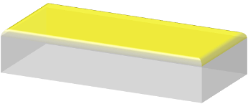


設計步驟
完成內部控制制度
依據風險評估結果，及審視該業務之重要性，決定應納入內部控制制度設計之業務項目，共通性業務部分得參採共通性作業範例辦理。
建立檢查機制
敘明該項業務之監督方式，並訂定適用機關自行檢查之表件格式。
設計控制作業
針對選定業務項目，設計控制重點。
選定業務項目
參考行政院所屬各機關風險管理及危機處理作業基準與作業手冊之觀念、方法評估風險。
依據既有整體層級目標確認作業層級目標 。
41
Notes:
Transparent 3-D steps with labels
(Advanced)
To reproduce the bottom rectangle shape with text effects on this slide, do the following:
On the Home tab, in the Slides group, click Layout, and then click Blank.
On the Home tab, in the Drawing group, click the More arrow on the Shapes gallery, and then under Rectangles, click Rectangle (first option from the left). On the slide, drag to draw a rectangle.
Under Drawing Tools, on the Format tab, in the Size group, do the following:
In the Shape Height box, enter 1.5”.
In the Shape Width box, enter 3”.
On the Home tab, in the bottom right corner of the Drawing group, click the Format Shape dialog box launcher. In the Format Shape dialog box, click Fill in the left pane, and then do the following in the right pane:
Select Solid fill.
Click the button next to Color, and then under Theme Colors click White, Background 1 (first row, first option from the left).
In the Transparency box, enter 0%.
Also in the Format Shape dialog box, click Line Color in the left pane, and then select No line in the right pane.
Also in the Format Shape dialog box, click 3-D Rotation in the left pane. In the right pane, click the button next to Presets, and then under Parallel click Off Axis 2 Top (third row, second option from the left).
Also in the Format Shape dialog box, click 3-D Format in the left pane, and then do the following in the right pane:
Under Bevel, click the button next to Top, and then under Bevel click Circle (first row, first option from the left). Next to Top, in the Width box, enter 7 pt, and in the Height box, enter 7 pt.
Under Depth, click the button next to Color, and then under Theme Colors click White, Background 1 (first row, first option from the left). In the Depth box, enter 40 pt.
Under Surface, click the button next to Material, and then under Translucent click Clear (third option from the left). Click the button next to Lighting, and then under Special click Two Point (second option from the left). In the Angle box, enter 70°.
On the Insert tab, in the Text group, click Text Box, and then on the slide, drag to draw the text box.
Enter text in the text box, select the text, and then on the Home tab, in the Font group, select TW Cen MT Condensed from the Font list and then select 36 from the Font Size list.
On the Home tab, in the Paragraph group, click Align Text Right to align the text right on the slide.
Drag the text box and position it over the rectangle.
Under Drawing Tools, on the Format tab, in the WordArt Styles group, click the arrow next to Text Fill, and then under Theme Colors click White, Background 1 (first row, first option from the left).
Select the text box. Under Drawing Tools, on the Format tab, click Text Effects, then point to 3-D Rotation, and then click 3-D Rotation Options.
In the Format Text Effects dialog box, click 3-D Rotation in the left pane. In the right pane, click the button next to Presets, and then under Parallel click Off Axis 2 Left (second row, fourth option from the left).
To reproduce the background on this slide, do the following:
Right-click the slide background area, then click Format Background. In the Format Background dialog box, click Fill in the left pane, select Gradient fill in the right pane, and then do the following:
In the Type list, select Linear.
Click the button next to Direction, and then click Linear Diagonal (first row, third option from the left).
In the Angle box, enter 135%.
Under Gradient stops, click Add or Remove until two stops appear on the slider.
Under Gradient stops, on the slider, customize the gradient stops as follows:
Click on the left stop, and then do the following:
In the Stop position box, enter 0%.
Click the button next to Color, and then under Theme Colors click White, Background 1 (first row, first option from the left).
Select Stop 2 from the list, and then do the following:
In the Stop position box, enter 100%.
Click the button next to Color, and then under Theme Colors click White, Background 1, Darker 15% (third row, first option from the left).
On the Home tab, in the Drawing group, click the More arrow on the Shapes gallery, and then under Rectangles, click Rectangle (first option from the left). On the slide, drag to draw a rectangle.
Select the rectangle. Under Drawing Tools, on the Format tab, in the Size group, do the following:
In the Shape Height box, enter 0.33”.
In the Shape Width box, enter 10”.
On the Home tab, in the Drawing group, click the arrow next to Shape Fill, and then under Theme Colors click White, Background 1, Darker 15% (third row, first option from the left).
On the Home tab, in the Drawing group, click the arrow next to Shape Outline, and then click No Outline.
On the Home tab, in the Drawing group, click Shapes, and then under Basic Shapes, click Right Triangle (first row, fourth option from the left).
On the slide, drag to draw a triangle.
Select the triangle. Under Drawing Tools, on the Format tab, in the Size group, do the following:
In the Shape Height box, enter 1.33”.
In the Shape Width box, enter 10”.
On the Home tab, in the Drawing group, click the arrow next to Shape Fill, and then click White, Background 1, Darker 15% (third row, first option from the left).
On the Home tab, in the Drawing group, click the arrow next to Shape Outline, and then click No Outline.
Position the rectangle and the triangle so that the bottom edge of the triangle and the top edge of the rectangle are touching. Press and hold SHIFT and select both the rectangle and the triangle.
On the Home tab, in the Drawing group, click Arrange, and then do the following:
Under Group Objects, click Group.
Point to Align, and then click Align Center.
Point to Align, and then click Align Bottom.
On the Home tab, in the Clipboard group, click the arrow next to Copy, and then click Duplicate.
Under Drawing Tools, on the Format tab, in the Arrange group, click the arrow next to Rotate, and then click More Rotation Options.
In the Format Shape dialog box, on the Size tab, under Size and rotate, in the Rotation box, enter 180°.
On the Home tab, in the Drawing group, click Arrange, point to Align, and then do the following:
Click Align Center.
Click Align Top.
On the Home tab, in the Drawing group, click the arrow next to Shape Fill, and then under Theme Colors click White, Background 1 (first row, first option from the left).
To reproduce the original text and rectangle, do the following:
Press and hold SHIFT and select the original text box and rectangle. On the Home tab, in the Drawing group, click Arrange, and then under Group Objects click Group.
On the Home tab, in the Clipboard group, click the arrow next to Copy, and then click Duplicate. Repeat this step until you have a total of five groups of shapes.
On the Home tab, in the Editing group, click Select, and then click Selection Pane. In the Selection and Visibility pane, select each of the groups and drag on the slide to form a series of steps.
Also in the Selection and Visibility pane, press and hold CTRL and select all five groups of rectangles and text boxes.
On the Home tab, in the Drawing group, click Arrange, point to Align, and then click Distribute Horizontally.
On the Home tab, in the Drawing group, click Arrange, point to Align, and then click Distribute Vertically.
To change the text on the duplicate rectangles, click in each text box and edit the text.

Slide 43
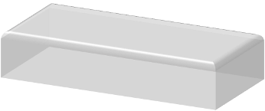

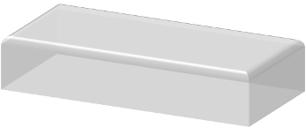

設計步驟
完成內部控制制度
建立檢查機制
設計控制作業
已發生內部控制缺失之業務項目
，應立即修正或設計控制重點。
選定業務項目
42
Notes:
Transparent 3-D steps with labels
(Advanced)
To reproduce the bottom rectangle shape with text effects on this slide, do the following:
On the Home tab, in the Slides group, click Layout, and then click Blank.
On the Home tab, in the Drawing group, click the More arrow on the Shapes gallery, and then under Rectangles, click Rectangle (first option from the left). On the slide, drag to draw a rectangle.
Under Drawing Tools, on the Format tab, in the Size group, do the following:
In the Shape Height box, enter 1.5”.
In the Shape Width box, enter 3”.
On the Home tab, in the bottom right corner of the Drawing group, click the Format Shape dialog box launcher. In the Format Shape dialog box, click Fill in the left pane, and then do the following in the right pane:
Select Solid fill.
Click the button next to Color, and then under Theme Colors click White, Background 1 (first row, first option from the left).
In the Transparency box, enter 0%.
Also in the Format Shape dialog box, click Line Color in the left pane, and then select No line in the right pane.
Also in the Format Shape dialog box, click 3-D Rotation in the left pane. In the right pane, click the button next to Presets, and then under Parallel click Off Axis 2 Top (third row, second option from the left).
Also in the Format Shape dialog box, click 3-D Format in the left pane, and then do the following in the right pane:
Under Bevel, click the button next to Top, and then under Bevel click Circle (first row, first option from the left). Next to Top, in the Width box, enter 7 pt, and in the Height box, enter 7 pt.
Under Depth, click the button next to Color, and then under Theme Colors click White, Background 1 (first row, first option from the left). In the Depth box, enter 40 pt.
Under Surface, click the button next to Material, and then under Translucent click Clear (third option from the left). Click the button next to Lighting, and then under Special click Two Point (second option from the left). In the Angle box, enter 70°.
On the Insert tab, in the Text group, click Text Box, and then on the slide, drag to draw the text box.
Enter text in the text box, select the text, and then on the Home tab, in the Font group, select TW Cen MT Condensed from the Font list and then select 36 from the Font Size list.
On the Home tab, in the Paragraph group, click Align Text Right to align the text right on the slide.
Drag the text box and position it over the rectangle.
Under Drawing Tools, on the Format tab, in the WordArt Styles group, click the arrow next to Text Fill, and then under Theme Colors click White, Background 1 (first row, first option from the left).
Select the text box. Under Drawing Tools, on the Format tab, click Text Effects, then point to 3-D Rotation, and then click 3-D Rotation Options.
In the Format Text Effects dialog box, click 3-D Rotation in the left pane. In the right pane, click the button next to Presets, and then under Parallel click Off Axis 2 Left (second row, fourth option from the left).
To reproduce the background on this slide, do the following:
Right-click the slide background area, then click Format Background. In the Format Background dialog box, click Fill in the left pane, select Gradient fill in the right pane, and then do the following:
In the Type list, select Linear.
Click the button next to Direction, and then click Linear Diagonal (first row, third option from the left).
In the Angle box, enter 135%.
Under Gradient stops, click Add or Remove until two stops appear on the slider.
Under Gradient stops, on the slider, customize the gradient stops as follows:
Click on the left stop, and then do the following:
In the Stop position box, enter 0%.
Click the button next to Color, and then under Theme Colors click White, Background 1 (first row, first option from the left).
Select Stop 2 from the list, and then do the following:
In the Stop position box, enter 100%.
Click the button next to Color, and then under Theme Colors click White, Background 1, Darker 15% (third row, first option from the left).
On the Home tab, in the Drawing group, click the More arrow on the Shapes gallery, and then under Rectangles, click Rectangle (first option from the left). On the slide, drag to draw a rectangle.
Select the rectangle. Under Drawing Tools, on the Format tab, in the Size group, do the following:
In the Shape Height box, enter 0.33”.
In the Shape Width box, enter 10”.
On the Home tab, in the Drawing group, click the arrow next to Shape Fill, and then under Theme Colors click White, Background 1, Darker 15% (third row, first option from the left).
On the Home tab, in the Drawing group, click the arrow next to Shape Outline, and then click No Outline.
On the Home tab, in the Drawing group, click Shapes, and then under Basic Shapes, click Right Triangle (first row, fourth option from the left).
On the slide, drag to draw a triangle.
Select the triangle. Under Drawing Tools, on the Format tab, in the Size group, do the following:
In the Shape Height box, enter 1.33”.
In the Shape Width box, enter 10”.
On the Home tab, in the Drawing group, click the arrow next to Shape Fill, and then click White, Background 1, Darker 15% (third row, first option from the left).
On the Home tab, in the Drawing group, click the arrow next to Shape Outline, and then click No Outline.
Position the rectangle and the triangle so that the bottom edge of the triangle and the top edge of the rectangle are touching. Press and hold SHIFT and select both the rectangle and the triangle.
On the Home tab, in the Drawing group, click Arrange, and then do the following:
Under Group Objects, click Group.
Point to Align, and then click Align Center.
Point to Align, and then click Align Bottom.
On the Home tab, in the Clipboard group, click the arrow next to Copy, and then click Duplicate.
Under Drawing Tools, on the Format tab, in the Arrange group, click the arrow next to Rotate, and then click More Rotation Options.
In the Format Shape dialog box, on the Size tab, under Size and rotate, in the Rotation box, enter 180°.
On the Home tab, in the Drawing group, click Arrange, point to Align, and then do the following:
Click Align Center.
Click Align Top.
On the Home tab, in the Drawing group, click the arrow next to Shape Fill, and then under Theme Colors click White, Background 1 (first row, first option from the left).
To reproduce the original text and rectangle, do the following:
Press and hold SHIFT and select the original text box and rectangle. On the Home tab, in the Drawing group, click Arrange, and then under Group Objects click Group.
On the Home tab, in the Clipboard group, click the arrow next to Copy, and then click Duplicate. Repeat this step until you have a total of five groups of shapes.
On the Home tab, in the Editing group, click Select, and then click Selection Pane. In the Selection and Visibility pane, select each of the groups and drag on the slide to form a series of steps.
Also in the Selection and Visibility pane, press and hold CTRL and select all five groups of rectangles and text boxes.
On the Home tab, in the Drawing group, click Arrange, point to Align, and then click Distribute Horizontally.
On the Home tab, in the Drawing group, click Arrange, point to Align, and then click Distribute Vertically.
To change the text on the duplicate rectangles, click in each text box and edit the text.

Slide 44
共通性業務
1.各機關內部控制制度中有關出納與財產管理、政風、科技發展計畫編審、主計、人事、行政管考、資訊安全、公共建設計畫與社會發展計畫編審及政府採購等共通性業務項目，得參採「政府內部控制共通性作業（含跨職能整合）範例製作原則」所稱之權責機關（單位）所定共通性作業（含跨職能整合）範例辦理。
2.共通性作業範例屬需優先處理範圍之作業項目，應即時納入內部控制制度。但在有效性前提考量下，得視各機關業務性質，合宜彈性調整控制作業及作業流程。
3.共通性作業範例非屬需優先處理範圍之作業項目，得暫不納入內部控制制度，並應監督及定期檢討；經檢討列入需優先處理範圍者，應依前目規定辦理。
43

Slide 45
跨職能業務
共通性作業跨職能整合範例因涉及機關內部不同單位(或業務)之作業，各機關宜視業務性質增納跨職能整合業務項目，並合宜彈性調整控制作業及作業流程，以強化源頭管理及整合關鍵控制重點。
44

Slide 46
個別性業務
屬需優先處理範圍之作業項目，應即時納入內部控制制度。
45

Slide 47
控制作業應設計之控制重點
績效考核
驗證核對
職能分工
實體控制

Slide 48
設計控制重點-績效考核
通常與覆核相結合，主要運用在高階主管對於機關內部各單位計畫與預算之管控，因為計畫和預算本身即可作為衡量標準，因此所採取的補救動作與追蹤措施，即為一種控制作業。
常見績效考核控制如 下：
比較本期與上期計畫及預算資訊。
比較財務資訊與非財務資訊。
比較計畫、預算間之關係。
47

Slide 49
設計控制重點~職能分工
重點在「分工」，主要目的在預防與及時發現在執行所分派職務時產生之錯誤或舞弊行為，是一項基本而且重要的控制活動。
常見的職能分工控制如下：
資產保管人員與會計人員分開。
交易授權與資產的保管分開。
營運責任與資料處理責任分開。
系統分析師、程式設計師不能兼辦資料輸入或電腦操作。
48

Slide 50
設計控制重點~驗證核對
驗證本身為一種證實的動作，將事項有關資訊加以紀錄核對，並加以驗證，即為一種控制作業，適當的憑證及紀錄係達成健全內部控制實施方案「提供可靠資訊」目標的基礎。
常見的驗證核對控制如下：
對收入事項的驗證及紀錄核對。
對支出事項的驗證及紀錄核對。
對非財務事項的驗證及紀錄核對。
49

Slide 51
設計控制重點~實體控制
實體控制主要係保護不動產、動產、有價證券、現金等，及已印妥但未使用之重要表單及其他重要紀錄的安全設施與防衛方法，定期盤點亦能達成保護上開資產的目標。
常見的實體控制控制如下：
存入銀行、保險箱或雇用警衛看守。
藉由抵押權或其他權利設定以確保債權。
定期對現金及固定資產進行盤點及抽查。
50

Slide 52
控制作業案例探討
內部控制制度案例1：動植物防疫檢疫局 內部控制制度案例2：國立臺中科技大學
內部控制制度案例3：國外出差旅費動支及報支作業流程

Slide 53
動動腦時間

Slide 54
您覺得有哪些控制重點

Slide 55
內部控制之自行評估

Slide 56
自行評估主要效益
提升同仁內部控制意識。
增進同仁對於作業流程的瞭解。
提早發現及改善內部控制缺失。
對於內部控制制度之有效性，提供定期驗證或聲明。
有助於內部稽核計畫及重點之擬定。
55

Slide 57
自行評估之規定1/2
各機關應研擬年度自行評估計畫（包括評估期間及範圍等），簽報機關首長核定。若有必要採取抽核程序以驗證評估重點之落實情形，應於自行評估計畫明定抽核方式、範圍及比率等，以作為執行依據。
各機關內部各單位應自行評估其內部控制落實情形，作成內部控制自行評估表，簽報單位主管簽章。嗣由研擬自行評估計畫單位彙整各單位內部控制自行評估表之評估情形及所發現之內部控制缺失或所提之興革建議，提經內部控制或內部稽核相關會議審議通過或簽陳相關召集人核定後，簽報機關首長，並交由內部稽核單位追蹤後續改善或興革建議辦理情形。
56

Slide 58
自行評估之規定2/2
各機關辦理自行評估時，審計部年度審核通知或中央政府總決算審核報告所列重要審核意見如提出機關內部控制機制未發揮應有效能等意見，應納入自行評估之重要參據
若自行評估之評估情形係落實，惟經內部稽核單位或上級主管機關等提出與該評估重點有關之內部控制缺失等意見時，該評估單位應於內部控制或內部稽核相關會議提出檢討報告及改善措施，並由內部稽核單位追蹤其改善情形。
機關業務屬性單純或規模較小者，得併由上級機關統籌辦理自行評估。
57

Slide 59
內部控制自行評估表
○○機關內部控制自行評估表
○○年度 評估單位：○○
評估期間：○○年○○月○○日至○○年○○月○○日
評估日期： 年 月 日
評估重點 | 評估情形 |  |  |  |  | 部分落實/未落實/不適用情形說明 | 改善措施/興革建議
 | 落實 | 部分 落實 | 未落實 | 未發生 | 不 適 用
一、評估機關目標無法達成之風險，並決定需優先處理之風險項目，以及定期滾動檢討風險評估，以因應內部及外部環境之改變。 | V
二、依據各項業務性質與時俱進檢討不合時宜之控制作業及作業流程，並落實執行各項控制作業。 | V
三、建立檢討主管法令規定機制，並針對外界意見或執行缺失部分即時檢討相關法令規定。 |  | V
……
八、稽核評估職能單位及負責內部控制或內部稽核業務幕僚單位依相關法令規定落實辦理下列工作
填表人： 複核： 單位主管：
58

Slide 60
內部控制自行評估表
註：
1. 各單位除上列必要評估重點外，另得視業務性質及外部意見等調整增列評估重點項目，並依評估結果於評估情形欄勾選「落實」、「部分落實」、「未落實」、「未發生」或「不適用」；其中「未發生」係指有評估重點所規範之業務，但評估期間未發生，致無法評估者；「不適用」係指評估期間法令規定或作法已修正，但評估重點未及配合修正者，或無評估重點所規範之業務等。
2. 「評估期間」係指本項作業自行評估所涵蓋之期間；「評估日期」指執行該項評估之日期。
3. 該評估重點係由稽核評估職能單位及負責內部控制或內部稽核業務幕僚單位自行填寫依其相關法令規定應辦理之工作，如施政績效管考、資訊安全稽核、政風查核(含廉政風險評估)、政府採購稽核、工程施工查核、國家關鍵基礎設施安全防護、人事考核(含考核工作績效及獎懲)、內部審核、事務管理工作檢核及定期檢討內部控制機制等工作。
4. 本表及其佐證資料等，應自辦理自行評估工作結束日起，以書面文件或電子化型式至少保存五年。
59

Slide 61
自行評估重點1/2
一、評估機關目標無法達成之風險，並決定需優先處理之風險項目，以及定期滾動檢討風險評估，以因應內部及外部環境之改變。
二、依據各項業務性質與時俱進檢討不合時宜之控制作業及作業流程，並落實執行各項控制作業。
三、建立檢討主管法令規定機制，並針對外界意見或執行缺失部分即時檢討相關法令規定。
四、遵循相關法令規定或契約。
五、就涉及人民權利或義務之主管業務建立適當之檢核、審查、追蹤、管制或考核等管理機制，並除依法公開外，另依風險評估結果，推動其行政作業流程透明措施，以利外部監督及型塑廉能政府。
60

Slide 62
自行評估重點2/2
六、就主管業務對相關機關或單位善盡監理、督導或輔導等責任。
七、針對內部高風險業務設有明確職能分工及職務輪調等機制。
(由機關自行指定之單位負責評估，其餘單位免列示本項)
八、稽核評估職能單位及負責內部控制或內部稽核業務幕僚單位依相關法令規定落實辦理下列工作(註3)：
(一)施政績效管考。
(二)…
(三)定期檢討內部控制機制。
(非稽核評估職能單位、內部控制或內部稽核業務幕僚單位免列示本項)
61

Slide 63
自行評估案例探討

Slide 64
自行評估案例3-1
佐證資料收集
作業項目-應用系統上線及變更管理作業
評估重點-系統維護人員及系統管理人員角色是否區隔，由不同人員擔任。
母體-102年11月30日至103年11月30日系統維護申請單
樣本-系統維護申請單評估期間總筆數約810筆，則依評估計畫所訂抽核標準表，隨機抽取評估所需最少樣本量25筆。
評估-驗證該25筆資料是否皆符合評估重點，並依實際結果勾選自行評估情形。
63

Slide 65
自行評估案例3-2
佐證資料收集
作業項目-人事費薪給作業
評估重點-是否隨時將人員動態以派令或異動通知單等資料，確實通知秘書室事務管理科及主計室。
母體-102年11月30日至103年11月30日人員派令或異動通知單。
樣本-人員派令或異動不定期且評估期間總筆數約300筆，依評估計畫所訂抽核標準表，隨機抽取評估所需最少樣本量25筆。
評估-驗證該25筆資料是否皆符合評估重點，並依實際結果勾選自行評估情形。
64

Slide 66
自行評估案例3-3
佐證資料收集
作業項目-採購作業(履約管理及驗收單位)
評估重點-廠商有無依契約履約、是否依契約約定辦理檢(試)驗、查驗，並督促廠商注意履約品質、工程採購廠商依規定報竣工，機關是否迅速確認竣工並注意廠商無虛報竣工，以規避逾期違約金之情形。
母體-102年11月30日至103年11月30日採購案件。
樣本-採購案件評估期間總筆數約7筆，依評估計畫所訂抽核標準表，隨機抽取評估所需最少樣本量1筆。
評估-驗證該筆資料是否皆符合評估重點，並依實際結果勾選自行評估情形。
65

Slide 67
內部控制之內部稽核

Slide 68
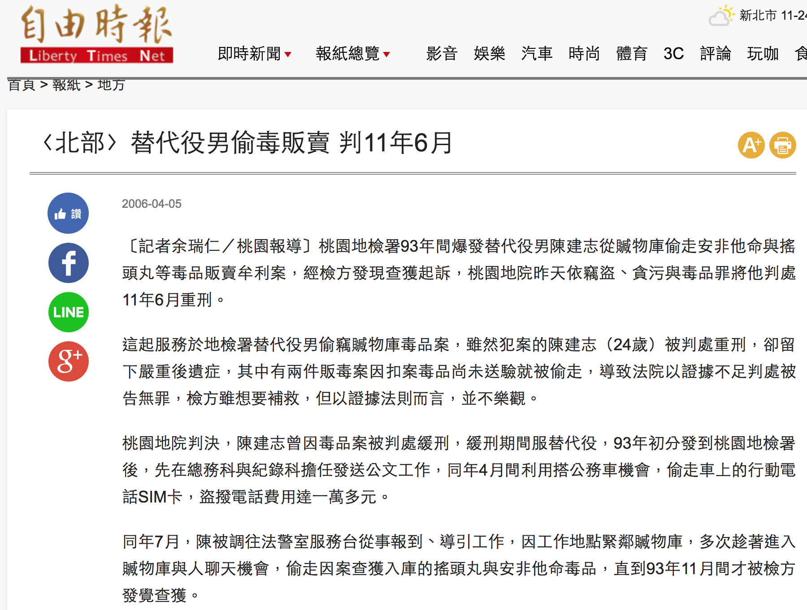
內部稽核的威力
Notes:
67

Slide 69
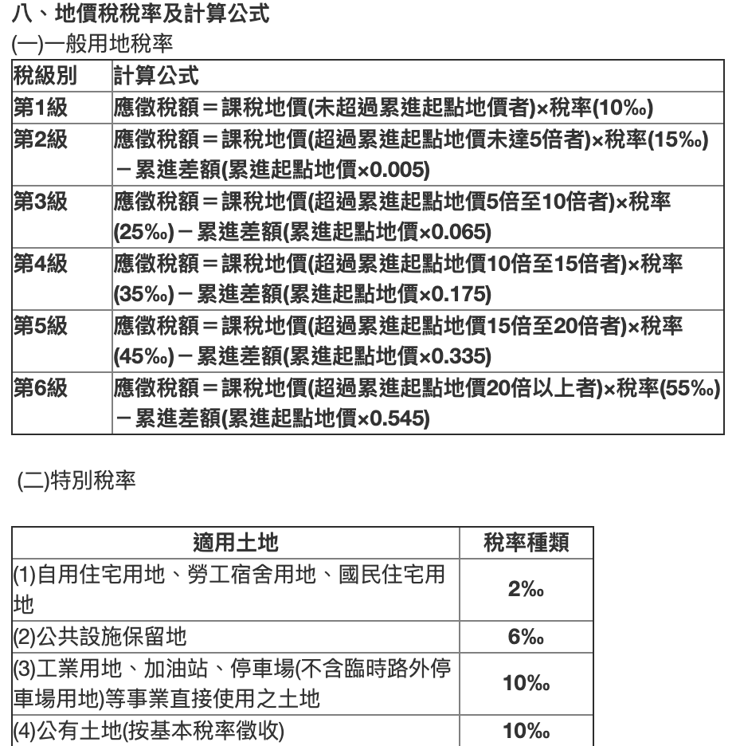
內部稽核的威力
Notes:
68

Slide 70
內部稽核流程
工作文件準備
規畫稽核計畫
成立稽核小組
訓練稽核人員
召開啟始會議
執行稽核作業
製作稽核報告
召開總結會議
執行矯正措施
矯正結果跟催
稽核紀錄彙整
召開檢討會議
受稽單位準備
∣←稽核前準備作業→∣
←稽核施行作業→∣
←矯正與跟催作業→∣

Slide 71
稽核前準備作業

Slide 72
規畫稽核計劃
1.年度稽核規劃
每年應至少各辦理一次，稽核之期間至少應涵蓋十二個月份，並可自前一年度開始進行跨年度之稽核，其前後年度之起迄時間應分別相互銜接。
2.專案稽核規劃
可針對指定案件或異常事項等辦理專案稽核。另辦理跨年度稽核時，如發現跨越前一年期間存有內部控制重大缺失，應就當年未能及時納入稽核期間，針對該等重大缺失擇定相關事項辦理專案稽核。
3.稽核計畫擬定
「年度稽核計畫」一般是由內控推動單位負責擬定。
71

Slide 73
規畫稽核計劃
4.受稽作業選定
所有「控制作業」皆應輪流排入，可視往常表現與重要性適當調整。並可以適當年度為周期，依據比例分批執行（如以三年為周期，每一年稽核三分之一，三年之內完成所有項目稽核）。
5.時程考量
排定「年度稽核計畫」時應考量避開工作旺季（如上級督導、年終盤點、年底結案）。
6.核准
「年度稽核計畫」應呈送內控小組召集人核准。
7.變更
「年度稽核計畫」需變更時，應由原排定及核准人重行審查。
72

Slide 74
成立稽核小組
1.召集人
各機關應成立內部稽核單位辦理內部稽核工作，並由副首長以上人員擔任召集人。但業務屬性單純或規模較小者，得併由上級機關統籌辦理，並得統籌調派所屬人力交互檢查。
2.幕僚單位
機關採任務編組方式設置內部稽核單位者，其幕僚作業原則由綜合規劃單位辦理。但機關首長得視機關屬性及業務性質指定適當單位辦理之。
73

Slide 75
成立稽核小組
3.稽核人員組成
(1)各機關內部稽核工作得視業務需要，調度施政管考、資訊安全稽核、政風查核、政府採購稽核、工程施工查核、國家關鍵基礎設施安全防護、人事考核、內部審核、事務管理工作檢核及其他稽核職能(以下簡稱稽核評估職能)單位人員及主要核心或高風險業務等單位人員辦理
(2)稽核人員不得針對過去一年內、目前或即將負責承辦業務執行稽核。
(3)前項所定過去一年內，其他法令有特別規定者，從其規定。
74

Slide 76
訓練稽核人員
稽核人員應接受如下訓練。
1.內部控制之相關訓練
2.內部稽核訓練
3.內部稽核實務演練

Slide 77
工作文件準備
1.取得並檢視控制作業
先行了解受稽單位之「控制作業」與「控制重點」。
2.發出內部稽核通知
通知受稽單位應準備事項。
3.製作內部稽核查檢表
依「控制作業」之「控制重點」內容編製「內部稽核查檢表」。
76

Slide 78
受稽單位準備
1.安排與稽核員等數量之陪審人員。
2.將稽核日期與行程通知相關人員，並要求各業務承辦人員於當時在場。
3.各業務承辦人員若因故無法在場時，應指定職務代理人。
4.備妥內部稽核所需要之標準文件與執行紀錄。
5.啟始與總結會議的場地安排
77

Slide 79
稽核施行作業

Slide 80
召開啟始會議
1.雙方開場白及成員介紹。
2.說明稽核方式及範圍。
3.稽核時間表說明與再度確認。
4.稽核調查結果的後續行動說明。
5.約定總結會議的時間。
79

Slide 81
執行稽核作業
1.稽核方式
(1)以事前製作完成的「內部稽核查檢表」逐項查證。
(2)將查證的結果記載於「內部稽核查檢表」上。
(3)若查證結果符合要求，則進行下一項目之查證。
(4)若查證結果不符合要求，則將客觀證據收集妥當，以作為開立「內部稽核報告」之依據。
80

Slide 82
執行稽核作業
2.運用5W2H技巧詢問
(1)Who：誰負責？誰審核？異常誰處理？
(2)What：哪些項目？哪些事情？哪些物品？
(3)When：什麼時候？
(4)Where：什麼地方？
(5)How：怎麼做？
(6)Why：為什麼？原因？
(7)How much（many）：多少？
81

Slide 83
執行稽核作業
3.稽核應考量之重點
控制作業之完整性
控制作業之合理性
控制作業之執行效能
是否有採取捷徑之出軌狀況
是否有使用個人系統的情形
82

Slide 84
製作內部稽核報告
1.內部稽核報告之撰寫
(1)撰寫「內部稽核報告表」時應尋找避開受稽人員之獨立空間。
(2)「內部稽核報告表」之撰寫主要依據「內部稽核查檢表」上所登載之不符合項目。
(3)稽核報告應詳實記錄5W2H。
(4)「內部稽核報告表」應附上蒐集到之「客觀證據」。
83

Slide 85
製作內部稽核報告
2.內部稽核報告缺失之敘述
(1)在場人員(Who)
(2)發生之事實或物品What)
(3)發生之時間(Where)
(4)發生之地點(Where)
(5)構成缺失的原因(Why)
(6)缺失情形如何(How)
(7)多少數量(How Much、How Many)
84

Slide 86
製作內部稽核報告
內部稽核報告缺失之範例
(Where)在料品倉庫
(What)發現堆置一批無任何標識之料品
(Who)經向在場之料品管理人員陳○○查證
(When)係為上星期六驗收未過之不合格品
(Why)因請購人休假，尚未採取任何處理措施
(How)部分品項之包裝不完整
(How Many)帳上數字為24件，實際清點為21件
85

Slide 87
內部稽核報告格式
○○機關
○○年度(○○年○○專案)稽核報告
壹、稽核日期及受稽核單位
說明實際執行稽核工作之日期及受稽核單位。
貳、稽核結果
參、未來有關管理及績效重大挑戰之預警性意見
得敘明對機關形成挑戰之原因、目前因應作為及未來尚待加強之作為。
項次 | 稽核項目 | 稽核發現 | 稽核結論 | 改善措施/ 興革建議
1 | 年度採購案執行情形。 | 經調查○○年度各單位辦理採購案件預定招標彙整表，包括透過共同供應契約採購案等，其提報彙整控管標準不一。 | ○○年度各單位辦理採購案件預定招標彙整表中無明確彙整控管標準。 | 建議研議提報彙整控管標準，供各單位參考，以利後續管考。

Slide 88
召開總結會議
1.由稽核人員感謝受稽核單位及人員之合作。
2.重述啟始會議中所述之稽核範圍及方式。
3.強調稽核乃以抽樣方式進行，若無不符合要項被提出，並不代表不符合要項不存在。
4.對於此次稽核所察覺到的優點予以口頭勉勵。
5.依按照順序以口頭報告各不符合事項所發現之客觀證據。
87

Slide 89
矯正與跟催作業

Slide 90
執行矯正措施
1.修改相關規定，以符合實際執行所需。
2.修改現行作業方式，以符合相關規定。
3.補充執行目前遺漏實施之工作。
89

Slide 91
矯正結果跟催
1.約定時間進行複查。
2.缺失單位說明改善經過及結果。
3.增加抽樣件數及範圍。
4.確認實際執行情形。
5.決定辦理結案或持續追蹤。
90

Slide 92
稽核紀錄彙整
1.收集內部稽核查檢表。
2.核對稽核缺失與內部稽核報告。
3.確認內部稽核報告完成情形。
4.確認受稽單位回覆情形。
5.彙整製作內部稽核缺失及跟催結果明細。
91

Slide 93
召開檢討會議
1.稽核人員報告稽核所見缺失及建議。
2.缺失單位說明改善經過及結果。
3.疑義部分討論。
4.討論事項作成決議。
5.持續追蹤及檢討。
92

Slide 94
內部稽核案例探討
內部稽核案例1：資訊系統委外開發及維護採購案
內部稽核案例2：財產及物品管理查核
內部稽核案例3：ＯＯ地區補助計畫

Slide 95
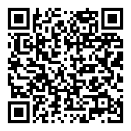
本次課程資料

Slide 96


敬請批評指教

